Slide 1
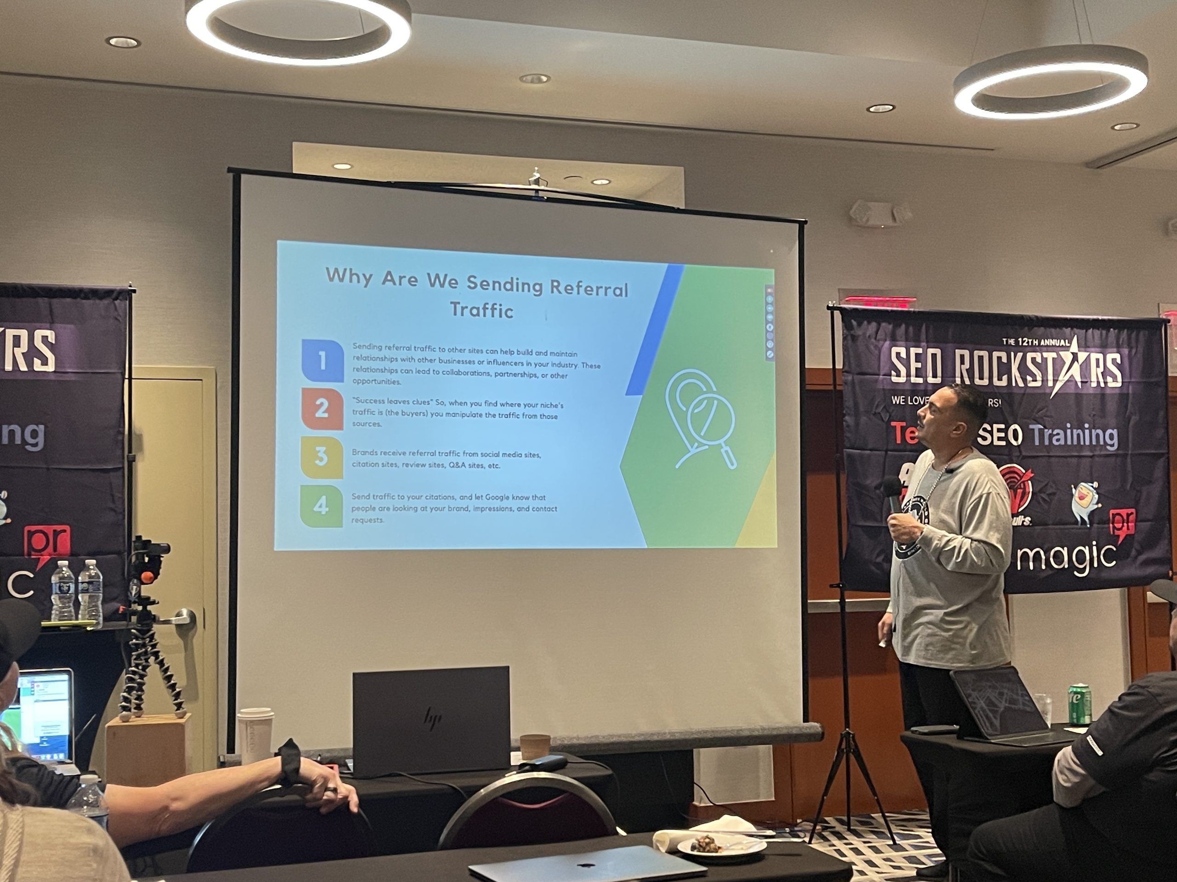

THE PERFECT WEBINAR
[ Your Webinar Title Goes Here ]
Presented by [ Presenter Name ]
[ Title / Company / Credibility line ]
Russell Brunson Perfect Webinar Framework | Fill-in template
Notes:
JOB: The title slide. Open strong. Put the webinar title (a clear big promise) and the presenter name. Keep it clean and credibility-forward, not a resume dump. This slide is on screen as people arrive, so it should already tease the transformation.

Slide 2

INTRO / HOOK
The Big Promise
By the end of this training you will know how to:
[ The #1 outcome they walk away with ]
[ Outcome 2 ]
[ Outcome 3 ]
Who this is for:
[ Describe exactly who should stay to the end ]
Notes:
JOB: Grab attention and set the frame. State the BIG PROMISE (what they walk away with if they stay to the end) and hand them a RULER: a specific way to measure success so they judge themselves by your metric, not their own doubt. Set the expectation: stick around to the end, there is something special for people who finish. 5 to 10 min.

Slide 3
INTRO / HOOK
The ONE Thing I Will Teach You
[ Name the single skill / result you are teaching today ]
Why it matters right now:
[ One or two lines on why this ONE thing changes everything for them ]
Notes:
JOB: Focus the audience on the single valuable thing you will teach. Do NOT promise five things. One clear teaching keeps attention and sets up the Big Domino later. Clarity here is what makes the rest of the webinar land.

Slide 4
ORIGIN STORY
My Story
BEFORE
[ Where you were: struggling, skeptical, stuck ]
THE EPIPHANY
[ The moment everything changed for you ]
AFTER
[ The result / transformation you now have ]
Notes:
JOB: The Epiphany Bridge. Tell YOUR transformation story so the audience FEELS what you felt and arrives at the same conclusion you did. Before (the struggle), the epiphany (the turning point), after (the result). The story builds trust and authority and it sets up the belief shift. End it by bridging into the ONE belief / Big Domino. 10 to 15 min.

Slide 5
THE BIG DOMINO
!
The Big Domino
The ONE belief that makes the sale inevitable:
[ "If I can get you to believe ______ , then the next step becomes obvious." ]
What goes here:
[ Name your framework / method (the VEHICLE) with a memorable name, e.g. The 3-Step ______ Method. If they accept this one belief, every other objection becomes irrelevant. Convince them of ONE thing, never two. ]
Notes:
JOB: The Big Domino is the single belief that, once accepted, knocks down every other objection. Do not split focus across multiple ideas, conversions collapse when you do. Classic form: 'If I can convince you of [ONE THING], you have to take the next step.' Name your framework/method here, this becomes the VEHICLE the 3 Secrets defend.

Slide 6
THE 3 SECRETS
1
SECRET 1
Break the VEHICLE Belief
The false belief: "This opportunity / method does not even work."
Story that breaks it:
[ Short story or client case study that shatters this belief ]
Teach one real piece of value:
[ One framework / step / insight tied to this belief ]
Trial close:
[ "Does that make sense? Can you see how this works for you?" ]
New belief: New belief to install: the VEHICLE itself is legitimate and works.
Notes:
JOB (Secret 1): This makes them believe the OPPORTUNITY works, before you ever mention your product. Run the mini-structure: state the false belief, tell a short story that breaks it, teach ONE real piece of value, land the new belief, then trial close with an easy yes/no. Aim for a small 'yes' every few minutes. The 3 Secrets are the core content block, about 30 to 40 minutes total.

Slide 7

THE 3 SECRETS
2
SECRET 2
Break the INTERNAL Belief
The false belief: "It works for others, but I cannot do it."
Story that breaks it:
[ Short story or client case study that shatters this belief ]
Teach one real piece of value:
[ One framework / step / insight tied to this belief ]
Trial close:
[ "Does that make sense? Can you see how this works for you?" ]
New belief: New belief to install: YOU personally have what it takes to do this.
Notes:
JOB (Secret 2): This dissolves self-doubt: not technical enough, not smart enough, not me. Yes, you. Run the mini-structure: state the false belief, tell a short story that breaks it, teach ONE real piece of value, land the new belief, then trial close with an easy yes/no. Aim for a small 'yes' every few minutes. The 3 Secrets are the core content block, about 30 to 40 minutes total.

Slide 8

THE 3 SECRETS
3
SECRET 3
Break the EXTERNAL Belief
The false belief: "Outside forces (time, money, tools) will stop me."
Story that breaks it:
[ Short story or client case study that shatters this belief ]
Teach one real piece of value:
[ One framework / step / insight tied to this belief ]
Trial close:
[ "Does that make sense? Can you see how this works for you?" ]
New belief: New belief to install: outside obstacles will not stop you either.
Notes:
JOB (Secret 3): This removes the last external objections: no time, no money, no resources, no support. Run the mini-structure: state the false belief, tell a short story that breaks it, teach ONE real piece of value, land the new belief, then trial close with an easy yes/no. Aim for a small 'yes' every few minutes. The 3 Secrets are the core content block, about 30 to 40 minutes total.

Slide 9
THE TRANSITION
The Transition
[ "Let me ask you a question..." ]
[ "Is it okay if I spend the next few minutes showing you the exact tool / program / service I built to help you do all of this?" ]
Then pause. Wait for the yes.
Notes:
JOB: The pivot from teaching to selling. Ask the magic transition question, then ask PERMISSION to pitch. Waiting for the yes earns the right to sell without breaking trust. Keep this slide simple, it is a verbal moment more than a visual one. 2 to 3 min.

Slide 10
THE STACK
The Offer
Introduce the core offer by name:
[ IMAGE / VISUAL ]
(product / offer mockup)
[ Product / Program / Service Name ]
What it is:
[ What they get and the outcome it delivers ]
Standalone value:
[ $ value ]
Notes:
JOB: Start the Stack. Name the core offer and describe what it is plus the outcome it delivers. Show it on its own slide and state its standalone dollar value. This is item one of the running value stack that grows through the next slides.

Slide 11
THE STACK
Bonuses, Stacked
"You are also going to get this... and this... and this..."
[ Bonus 1: solves a leftover objection ]
[ $ value ]
[ Bonus 2 ]
[ $ value ]
[ Bonus 3 ]
[ $ value ]
[ Bonus 4 (optional) ]
[ $ value ]
[ Bonus 5 (optional) ]
[ $ value ]
Notes:
JOB: Stack the bonuses. Each bonus should knock out a leftover objection, often one bonus per Secret (tying back to the vehicle / internal / external belief breaks). Give each its own dollar value and keep the running total growing. Use the stacking line out loud.

Slide 12
THE STACK
Total Value, Stacked Up
[ Core offer ] [ $ value ]
[ + Bonus 1 ] [ $ value ]
[ + Bonus 2 ] [ $ value ]
[ + Bonus 3 ] [ $ value ]
[ + Bonus 4 / 5 ] [ $ value ]
TOTAL VALUE:
[ $ grand total ]
Notes:
JOB: Show the full stacked value adding up. Sum everything and frame it against a bigger anchor (if you bought all this separately it would cost $X). The visual stack growing is what makes the price on the next slide feel like an obvious deal.

Slide 13
THE CLOSE
The Price
Total value stacked:
[ $ total value ] (crossed out)
Your price today
[ $ actual price ]
Notes:
JOB: Reveal the actual price, framed as a steep discount off the stacked value. By now the perceived value should make the price feel small. Anchor high (the stack), then drop to the real number. Do not apologize for the price, state it with confidence.

Slide 14
THE CLOSE
Your Guarantee
[ SEAL ]
Remove all the risk:
[ State your guarantee / refund policy in plain language. e.g. Try it for N days. If it is not for you, get every dollar back. ]
Notes:
JOB: Handle risk. The guarantee removes the last objection by shifting risk off the buyer and onto you. Make it specific and generous enough to feel safe. This is what lets a fence-sitter say yes.

Slide 15
THE CLOSE
Why Act Now
FAST-ACTION BONUS
DEADLINE
LIMITED SPOTS
[ Extra bonus only if they buy in the next N minutes ]
[ Offer / cart closes at a specific time ]
[ Capped seats or quantity ]
Notes:
JOB: Add real urgency and scarcity so people act now instead of later (later means never). Pick one or combine: a fast-action bonus, a hard deadline, or limited quantity. It must be true. False scarcity destroys trust.

Slide 16
THE CLOSE
Get Started Now
Exactly how to take the next step:
[ CALL TO ACTION BUTTON ]
[ The exact link / URL to buy ]
[ Repeat the CTA clearly. Say it again, and again, as the close winds down. ]
Notes:
JOB: The call to action. Tell them exactly how to buy (button, link, phone number) and repeat it clearly and often, increasing frequency as you close. Every objection you answer should end by pointing right back to this CTA.

Slide 17

CLOSE
Questions and Thank You
Live Q&A:
[ Field questions. End every answer by pointing back to the offer / CTA. ]
Thank you:
[ Thank them for staying. Restate the promise and the deadline one last time. ]
Notes:
JOB: Optional live close. Handle objections in Q&A, and make each answer route back to the CTA. Close with gratitude, restate the big promise and the urgency once more. This is the last chance to convert the fence-sitters.

